Slide 1
Why You Can’t Win, Break Even, or Get Out of the Game
. . . Watching the digital dEMOLItion of our fourth amendment rights
Ideas & Intersections: DIGITAL PRIVACY
Nicholas johnson
April 7, 2015

Slide 2
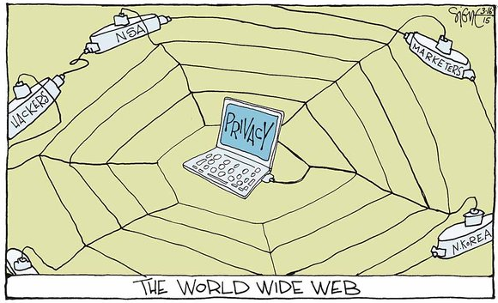
Ever Wonder Why We Call It “The Web”?
-- Cartoon Credit, Signe Wilkinson, March 16, 2015

Slide 3
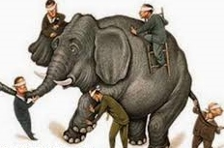
What Won’t We Be Talking About?
Loss of Privacy Topics
  Who wants our private info?
  What are their motives?
  What do they target?
  What tools do they use?

Slide 4
What Will We Be Talking About?
Privacy protections
Random Observations
The Fourth Amendment
A story about its evolution
A possible solution

Slide 5
Privacy Protection: What We Can Provide
Use strong passwords; air-wall passwords
Consider encryption
Be suspicious (phishing; unknown senders, photos, links)
Don’t share identity online (birthdate; mother’s name)

Slide 6
Privacy Protection: What Law Can Provide
UN Universal Declaration of Human Rights (Article 12)
European Union (right to be forgotten)
U.S. Constitution (Fourth Amendment)
General laws (federal Privacy Act)
Sector laws (children, health, education, library/ video rental records)
Common law (seclusion, defamation, false light, disclosure)
Personal privacy (contraceptives; abortion)
. . . And take away (Patriot Act; FISA)

Slide 7

Random Observations
. . . From Orwell . . .

Slide 8
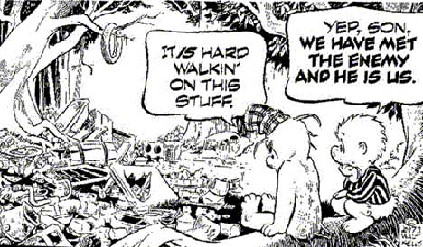
. . . to Pogo

Slide 9
UI Operations Manual
Acceptable Use of Information Technology Resources, Ch. 19.3:
      “The University . . . does not condone either censorship or the unauthorized inspection of electronic files.”

Slide 10
The Fourth Amendment
        “The right of the people to be secure in their persons, houses, papers, and effects, from unreasonable searches and seizures, shall not be violated . . ..”

Slide 11
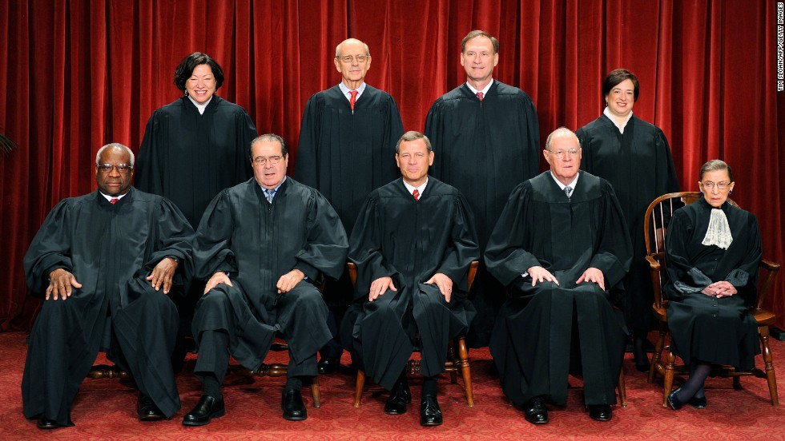
How Supreme Court Law is Made
Three cases: Olmstead, Katz, and Miller

Slide 12
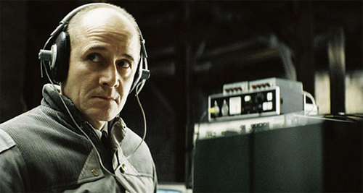
Olmstead v. United States (1928)
Fourth Amendment literalism

Slide 13
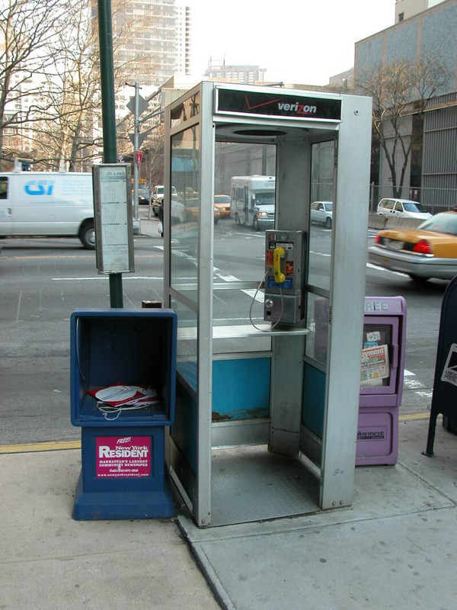
Katz v. United States (1967)
. . . and the “reasonable expectation of privacy.”

Slide 14
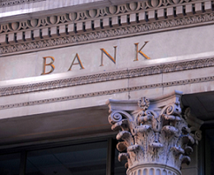
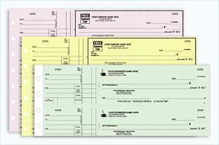
United States v. Miller (1976)
Bank’s records?
Or your records?

Slide 15
What Are Our Options?
Find Walden Pond; live “off the grid”
Accept our digital nakedness
Option Three

Slide 16
Option Three: “New Rules”
Default: Retain “reasonable expectation” if 3d party-only reception of personal info required for transaction
Simple, clear, short contract language
  Do nothing → Privacy protected; fee charged
  Free or cheap product/service → relinquish privacy
Prohibit gov’t access to third party data without warrant

Slide 17
Coordinates
Nicholas-Johnson@uiowa.edu
www.nicholasjohnson.org
FromDC2Iowa.blogspot.com

Slide 30
Title and Content Layout with Chart

Slide 31
Two Content Layout with Table
First bullet point here
Second bullet point here
Third bullet point here
 | Group 1 | Group 2
Class 1 | 82 | 95
Class 2 | 76 | 88
Class 3 | 84 | 90

Slide 32
Title and Content Layout with SmartArt
Step 1 Title
Task description
Task description
Step 2 Title
Task description
Step 3 Title
Task description
Task description
Task description

Slide 34
United States v. Miller (1976)
Bank
Financial records
Picture
Picture

